Slide 1
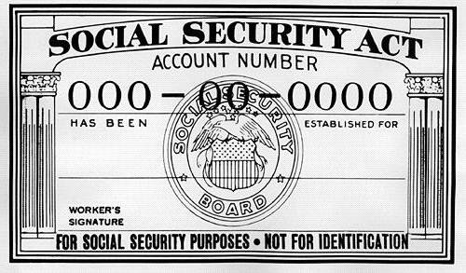
Social Security & RR Retirement Tier 1
Pub 17, Chapter 11
Pub 4012 Tab D
(Federal 1040-line 20)
Notes:
1

Slide 2
Printing of Social Security Documents
SSA discontinued providing SS number printouts effective 8/1/2014
Taxpayers who do not have their SS cards will need to complete application for a SS card (Form SS-5) and provide required documentation
SSA stopped providing benefit verification letters in their offices on 10/1/2014
Taxpayers can get instant letter online or may call SSA to request a letter by mail
Notes:
2

Slide 3
Tax On Social Security & Railroad Retirement Benefits Tier 1
Social Security (SS) and Railroad Retirement Benefits Tier 1 have same tax treatment
May be nontaxable or partially taxable, depending on total income from other sources
Up to 85% of benefits may be taxable
May be taxable if one-half of SS plus all other income (including tax-exempt interest) is greater than:
$32,000 MFJ
$25,000 single, HOH or qualified widow
$25,000 MFS & lived apart all year
$0 MFS & lived together any part of year
TaxSlayer calculates how much of SS is taxable on Federal return
Social Security and Railroad Retirement Benefits Tier 1 are not taxable in NJ
Note: There is no line item for them on NJ 1040
Notes:
3

Slide 4
Social Security & RR Retirement Benefits Tier 1
End-of-year statements
Social Security - SSA-1099 (disability or retirement)
Railroad Retirement Benefits Tier 1 - RRB-1099 (Blue Form)
Enter in Federal section \ Income \ Enter Myself \ IRA/Pension Distributions (1099-R, 1099-SSA) \ Social Security Benefits/RRB-1099
Include Medicare Parts B (Hospital Insurance), C (Medicare Advantage), & D (Prescription Drug coverage) on Social Security screen
TS includes these premiums as Itemized Deductions on Sch A
Notes:
4

Slide 5
Sample SSA-1099 Form
Enter on Social Security screen
Notes:
This is a sample SSA-1099 form showing how Social Security income & Medicare expenses are reported
When filling out Social Security screen, be sure to use the pink box (Box 5) not Box 3
The forms are sent out by Jan 31. Lost or missing copies can be obtained online or requested by phone (takes 10 days)
5

Slide 6
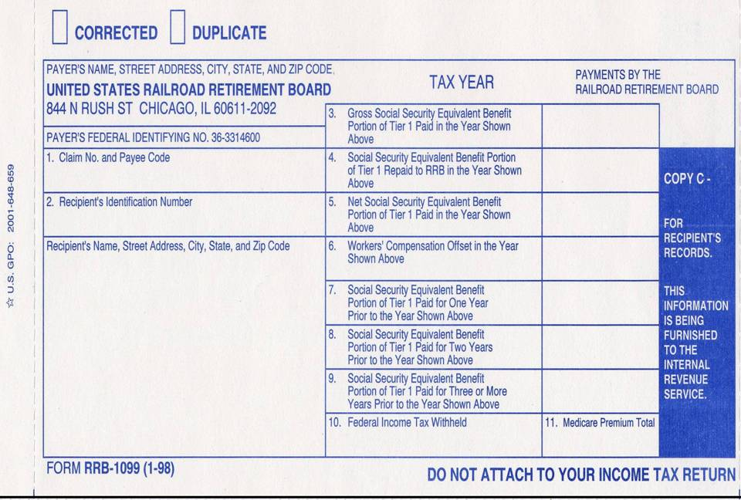
Railroad Retirement Benefits Tier 1 - Equivalent to Social Security
$15,972
Douglas Davis
210 Main Street
Bridgewater, NJ 08807
Enter on Social Security screen
$1,607
Notes:
Sample Railroad Retirement Benefits RRB-1099 showing how Railroad Retirement Tier 1 income & Medicare expenses are reported
6

Slide 7
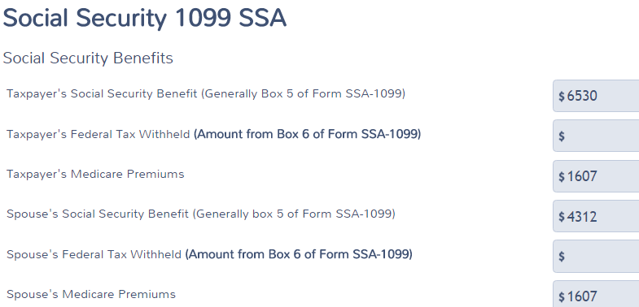
TS - Social Security/Railroad Retirements Benefits Tier 1 Federal section \ Income \ Enter Myself \ Distributions (1099-R, 1099-SSA) \ Social Security Benefits/RRB-1099
Social Security Box 5
Net benefits from SSA-1099 Box 5
Medicare premiums
Notes:
7

Slide 8
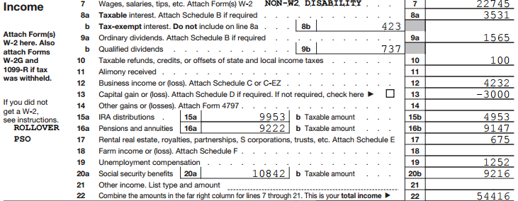
Social Security/Railroad Retirement Benefits Tier 1 on 1040 Line 20
Total Social Security
Taxable Social Security
Notes:
TS transfers Social Security income to 1040 Line 20a
TS automatically calculates how much of Social Security is taxable, based on total of taxpayer’s other income & populates on 1040 Line 20b
8

Slide 9
Medicare Expenses on Schedule A Screen
TS transfers from 1040
Wkt 1
Medicare premiums do not show here
Notes:
TS transfers Medicare Parts B, C, & D expenses from 1040 Wkt 1 to Schedule A Medical and Dental deductions. The Medicare premiums do not actually appear on the Medical Deductions screen or the Summary screen, but they are included in the Medical Expenses total
9

Slide 10
Social Security/Railroad Retirement Benefits Tier 1 – TS Tips
Use the amount from Box 5 of SSA-1099 or RRB-1099 as the Social Security amount
Don’t forget to look for Federal withholding
Always enter Medicare Parts B, C, & D even if the taxpayer isn’t planning on itemizing – may qualify for NJ lower medical threshold
Use a scratch pad on TaxPrep4Free.org to document the separate amounts and calculate the total
Notes:
10

Slide 11
Social Security/Railroad Retirement Benefits Tier 1 on NJ 1040
Neither Social Security nor Railroad Retirement Tier 1 is taxable for NJ so they do not flow through to NJ return
Medicare premiums entered on Social Security screen will flow through to medical expenses on NJ 1040 line 30 (if medical expenses exceed 2% of NJ gross income on line 28)
Therefore, NJ taxable income can change when you enter Social Security or Railroad Retirement Tier 1. Even though there is no new income on NJ return, the medical expense deduction can increase
Notes:
11

Slide 12
Lump Sum Social Security or RR Retirement Benefits Payments for Prior Years
Taxpayers may have received lump sum SS or RRB, including benefits from prior year(s)
Shown on SSA-1099A or RRB-1099, Box 3
Can pay the lower of:
Tax on total sum based on current tax year figures
Tax on additional taxable amount of SS/RRB Tier 1 based on prior years’ figures (lump sum election)
Must have copies of prior years’ returns to calculate this
Notes:
Sometimes it takes a long time for taxpayers to be approved for SS benefits (especially disability). Thus, once they are approved, they may receive back payments for prior year benefits as well as the current year benefit
Lump sum amount is shown in SSA-1099A Box 3 & a breakdown by year is given in Description box
Taxpayer can choose to pay 1 of 2 amounts, whichever is lower:
Tax on total lump sum payment based on current tax year figures
Tax on additional taxable amount of SS based on prior years’ figures (lump sum election)
Must have copies of prior years’ returns to use this method
12

Slide 13
Special Topic for Lump Sum Payments
Use Lump Sum Payment Worksheet to calculate best option
See TaxPrep4Free.org Special Topics document “Lump Sum Social Security Benefits” on Preparer page for instructions on how to handle SS/RRB Tier 1 lump sum payments

Slide 14
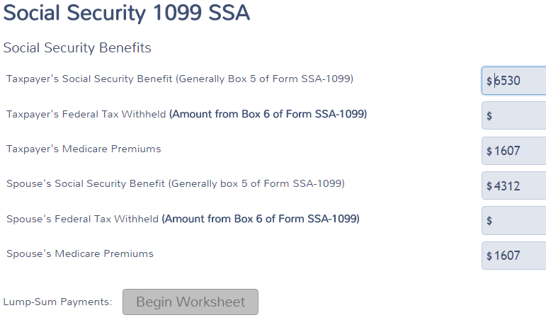
TS - Social Security/Railroad Retirement Benefits Tier 1 Lump Sum Payments Federal section \ Income \ Enter Myself \ Distributions (1099-R, 1099-SSA) \ Social Security Benefits/RRB-1099
Begin Lump Sum Payments Worksheet
Notes:
14

Slide 15
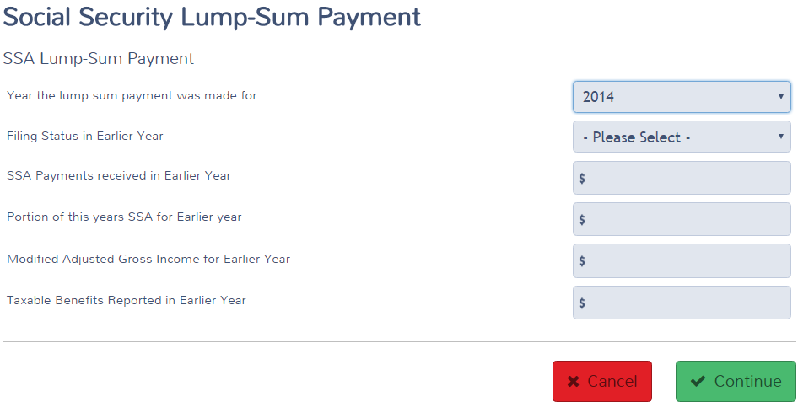
TS - Social Security/Railroad Retirement Benefits Tier 1 Lump Sum Payments Federal section \ Income \ Enter Myself \ Distributions (1099-R, 1099-SSA) \ Social Security Benefits/RRB-1099
Begin Lump Sum Payments Worksheet
Notes:
15

Slide 16
Foreign Old Age Payments for U.S. Residents
Old age payments from Canada & Germany
By treaty are added to/treated as Social Security (Pub 915)
Enter as normal on Social Security screen
Taxpayer must have converted amount into US dollars (bank statement shows)
Old age payments from United Kingdom are treated as Pension income
Security payments from Norway are excluded and not taxable in U.S.
Notes:
16

